Slide 1

Literature Survey
for
Integrated Modular Motor Drives
Mesut Uğur
09/04/2018
mesut.ugur@metu.edu.tr

Slide 2
Early Years
2002 - 2009

Slide 3
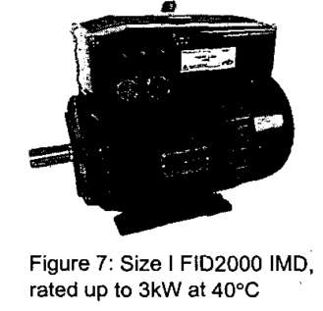
The idea of IMMD
The first idea of an Integrated Modular Motor Drive as we know of was brought forward in 2002.
Y Shakweh, G H Owen, D J Hall, H Miller
FKI Industrial Drives Ltd, UK, 2002
PLUG AND PLAY INTEGRATED MOTOR DRIVES
IMDs technology
Customer’s concerns, market status, future trends
Technical challenges to increase power ratings.
Today, IMD technology offers power output up to 7.5kW.

Slide 4
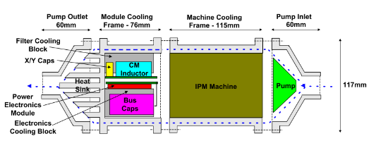
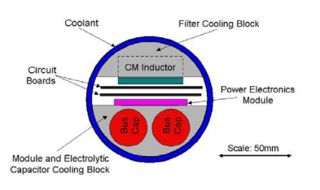
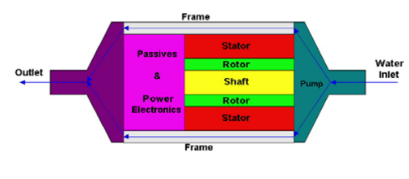
University of Wisconsion-Madison
Nathan C. Harris, Thomas M. Jahns, Surong Huang (with Lipo)
2002, Integrated Motor/Controller Drive for Automotive Water Pump Application
No hardware, No modularization.
500W, 42VDC, 5000rpm.
5 brushless machine topologies are discussed.Interior PM synchronous m/c is selected.
Six-switch PWM voltage-source inverter, power MOSFETs, integrated power electronics module (IPEM)
On Power Electronics side, physical layout, thermal management and EMI filter design are discussed

Slide 5
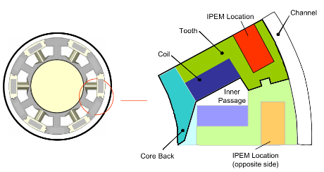
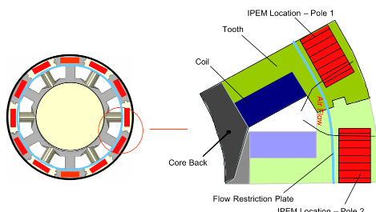
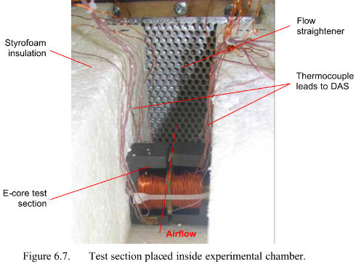
University of Wisconsion-Madison
Stephanie I. Mueller (MSc Thesis) with Professor Greg F. Nellis
2005, Model and Design of an Air-Cooled Thermal Management System for An Integrated Motor/Controller
Modular permanent magnet machine
Integrated power electronics module (IPEM)
Experimental verification with E cores?

Slide 6
University of Wisconsion-Madison
R. J. White, T.M. Jahns, and T.A Lipo
2005, Fault management techniques for an integrated modular motor drive
Bulunamadı
R. J. White, T.M. Jahns, and T.A Lipo, “Fault management techniques for an integrated modular motor drive,” in Proc. of 2005 CPES Power Electronics Seminar, Blacksburg, VA., Apr. 2005, pp. 581-588.

Slide 7
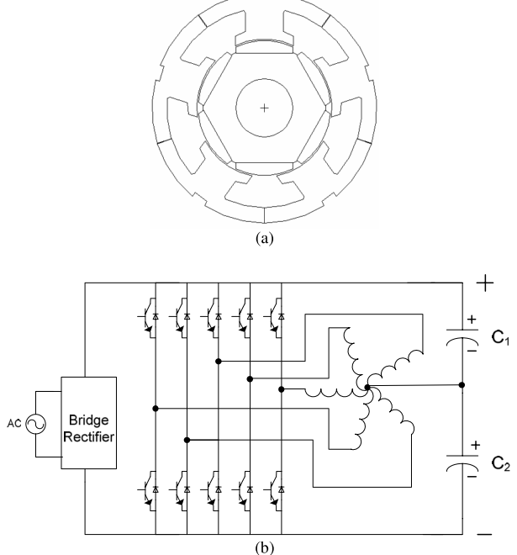
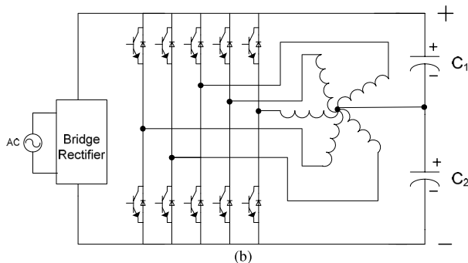
University of Wisconsion-Madison
Suman Dwari, Leila Parsa, and Thomas A. Lipo
2007, Optimum Control of a Five-phase Integrated Modular Permanent Magnet Motor Under Normal and Open-Circuit Fault Conditions
Simulation results, FEA, 5-phase
Integrated Modular Permanent Magnet Motor Drive (IMPMMD)
The torque pulsation has been decreased significantly

Slide 8
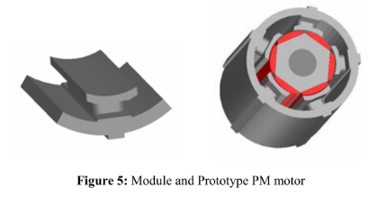
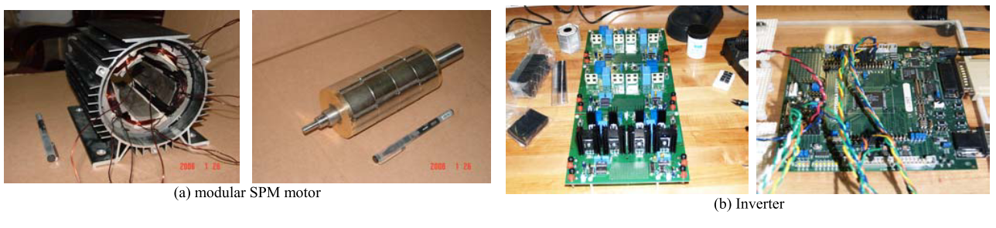
University of Wisconsion-Madison
Wen Ouyang, Nicholas Lemberg, Ruoping Yao*, T.A.Lipo
2007, A Novel Modular Permanent Magnet Drive System Design
Soft magnetic composites (SMC), flexible design options in 3D
Five-phase Modular SPM Motor, simulation results
The experiment setup work is still under way. The test results will be provided in the future report

Slide 9
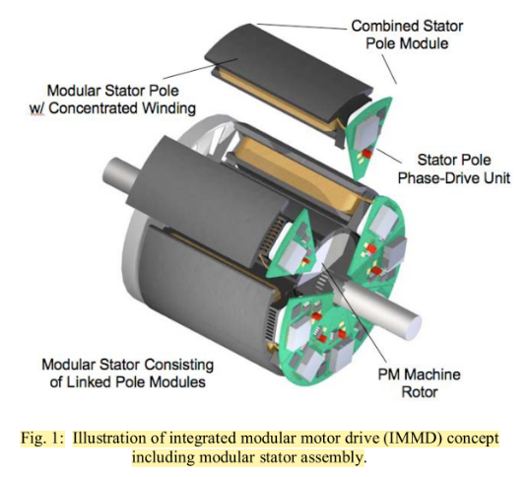
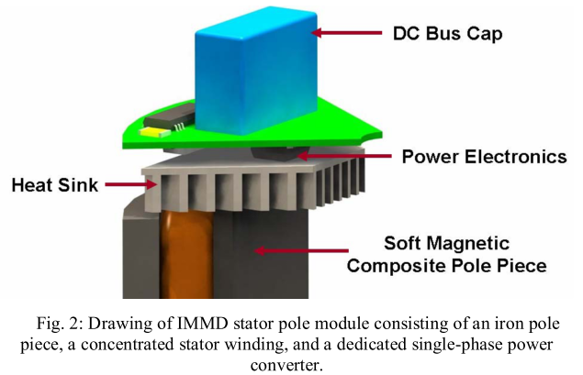
University of Wisconsion-Madison
N.R. Brown, T.M. Jahns, R.D. Lorenz
2007, Power Converter Design for an Integrated Modular Motor Drive
Five-phase machine, soft magnetic composite (SMC) material, six-pole surface PM rotor
2.7 kW, outer diameter is 120 mm, 400V dc bus, DC bus interconnections effect
Hard-switched half-bridge inverter phase-leg consisting of two IGBTs and anti-parallel diodes, 10kHz
DC bus capacitor, size requirement, experimental results with RL load, GMR sensors

Slide 10
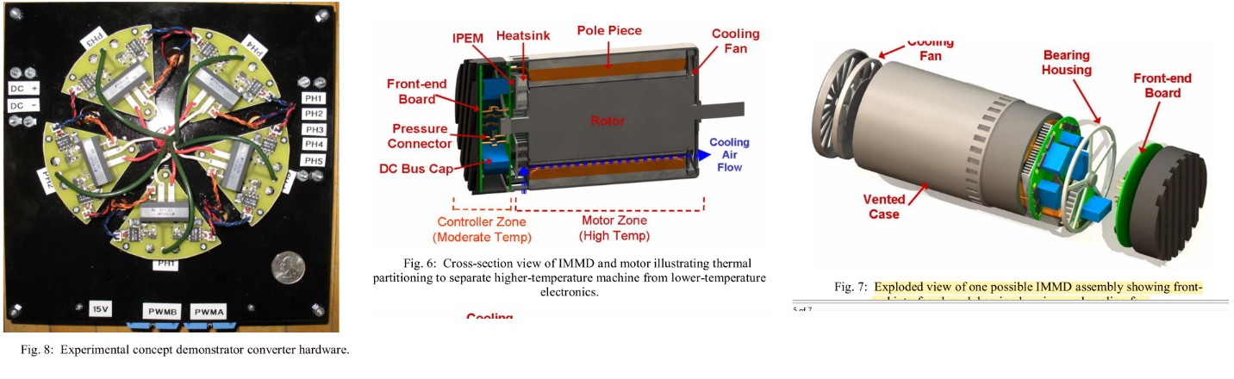
University of Wisconsion-Madison
N.R. Brown, T.M. Jahns, R.D. Lorenz
2007, Power Converter Design for an Integrated Modular Motor Drive

Slide 11
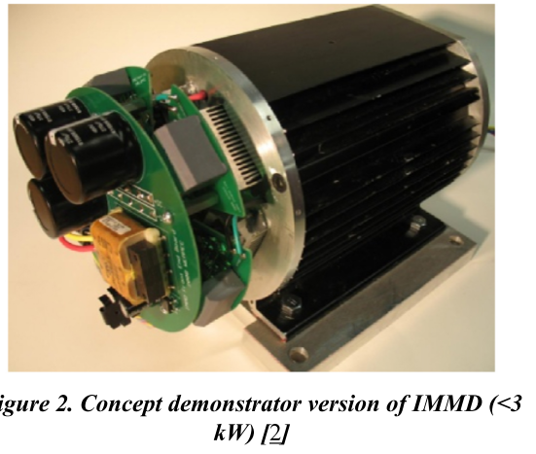
University of Wisconsion-Madison
Sykora, B. J., Jahns, T. M., and Lorenz, R. D
2008, Development of a Demonstrator Model of an Integrated Modular Motor Drive
Bulunamadı
Sykora, B. J., Jahns, T. M., and Lorenz, R. D., “Development of a Demonstrator Model of an Integrated Modular Motor Drive,” in Proc. 2008 NSF-CPES Annual Conference, Blacksburg, VA, April 2008.
B. J. Sykora, “Development of a demonstrator model of an integrated modular motor drive,” M.S. thesis, Dept. of Electr. and Computer Eng., University of Wisconsin- Madison, Madison, US, 2008

Slide 12
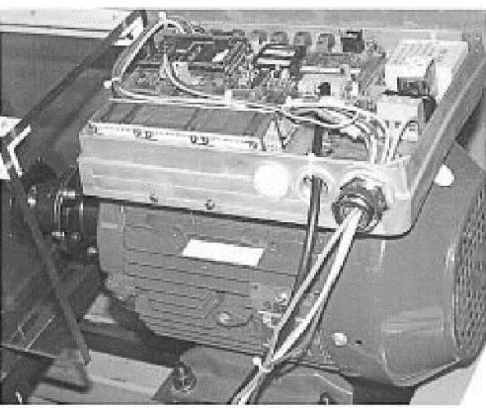
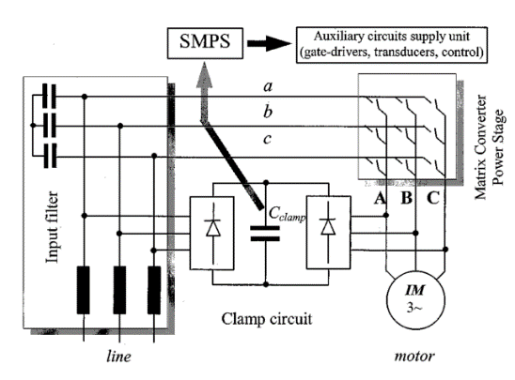
Aalborg University / Danfoss Drives
Christian Klumpner, Peter Nielsen, Ion Boldea, Frede Blaabjerg, Paul Thargersen
2002, Matrix Converter Motor (MCM) for Industry Applications
First integrated regenerative frequency converter motor for industry applications
Based on a matrix converter topology.
4-kW matrix converter motor prototype
No modularization
IGBT-diode

Slide 13
Aalborg University / Danfoss Drives
Christian Klumpner, Peter Nielsen, Ion Boldea, Frede Blaabjerg, Paul Thargersen
2003, Converter Topologies the Next Generation of Integrated Motor Drives
ASD converter topologies (inverter is the same, rectifier and dc link/passive sides are different)
No modularity
No hardware
Evaluation of the Converter Topologies suited for Integrated Motor Drives

Slide 14
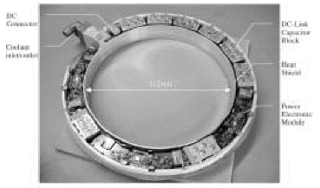
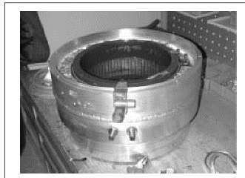
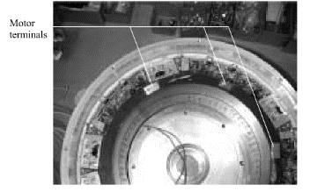
University of Stuttgart
J. Ranneberg, Y. Tadros, U. Schäfer
2004, Motor-Integrated Circular Converter for Hybrid Electric Vehicles
Motor-Integrated Circular Converter for Hybrid Electric Vehicles
Inserted in the stator housing around the end windings of the induction motor
200-400V, 50kW, IGBT, water cooled, No modularization, toroidal foil capacitor
Prototype

Slide 15
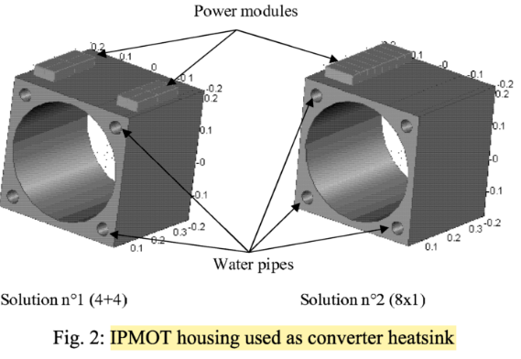
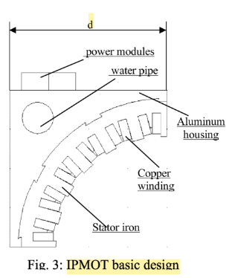
POLITECNICO DI TORINO, AACHEN UNIVERSITY
Francesco Farina, Daniele Rossi, Alberto Tenconi, Francesco Profumo, Stefan E. Bauer
2005, Thermal design of integrated motor drives for traction applications
25 kW SRM, water cooled square housing, IGBT based, Comsol simulations (2D FEM)
Integrated Propulsion MOTors (IPMOTs), pre-prototype is under construction

Slide 16
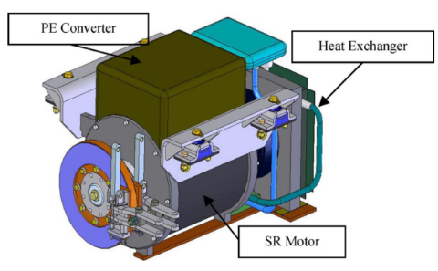
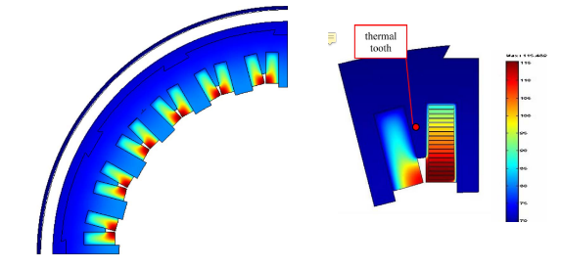
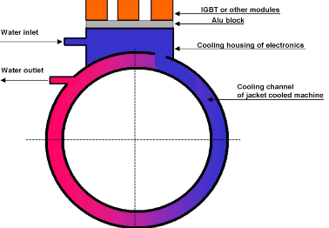
POLITECNICO DI TORINO, AACHEN UNIVERSITY
Alberto Tenconi, Francesco Profumo, Stefan E. Bauer, and Martin D. Hennen
2008, Temperatures Evaluation in an Integrated Motor Drive for Traction Applications
Liquid-cooled totally integrated drive unit Integrated Propulsion MOTor (IPMOT), 24-kW
Four-phase switched reluctance motor (SRM), IGBT based
Simulations (FEM) and thermal experimental setup

Slide 17
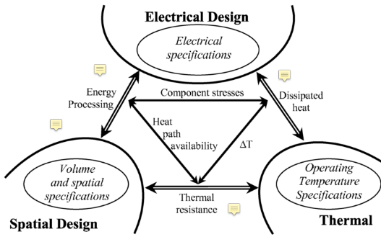
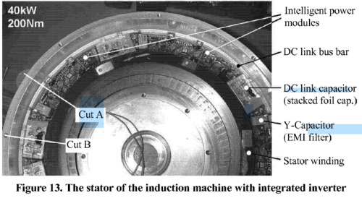
Delft Technical University, Erlangen
M. Gerber, Martin Marz
2005, System Integration in Automotive Power Systems
The interdependence of the electrical, the thermal and the spatial design
Two case studies (prototypes): engine coolants
1. 2kW automotive DC/DC converter that has a power density of 120W/in³, 14V/42V
2. Integrated drive for hybrid vehicles, IGBT

Slide 18
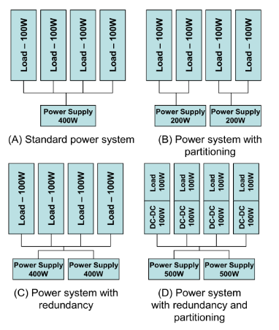
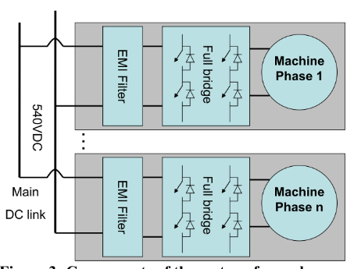
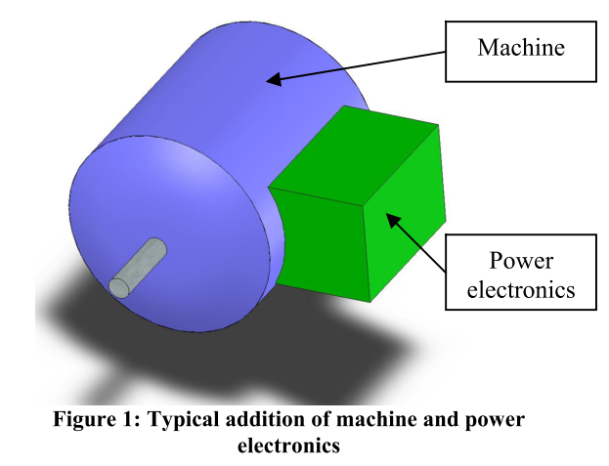
Delft Technical University
J.J. Wolmarans, M.B. Gerber, H. Polinder, S.W.H. de Haan, J.A. Ferreira, D. Clarenbach
2008, A 50kW Integrated Fault Tolerant Permanent Magnet Machine and Motor Drive
An overall goal of 2kW/kg is set for system power density
A 50kW, 6 phase, 8 pole permanent magnet machine is presented with a speed of 50krpm
+/-270VDC bus, as utilized in current and future new aircraft
“No single electrical fault may cause the system as a whole to stop functioning”
Simulation (mostly thermal)

Slide 19
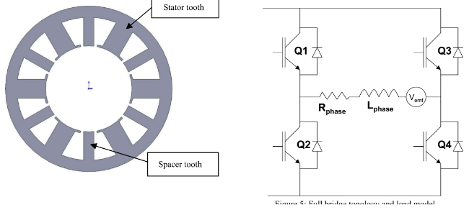
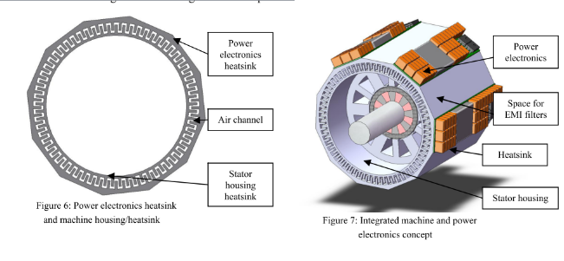
Delft Technical University
J.J. Wolmarans, M.B. Gerber, H. Polinder, S.W.H. de Haan, J.A. Ferreira, D. Clarenbach
2008, A 50kW Integrated Fault Tolerant Permanent Magnet Machine and Motor Drive

Slide 20
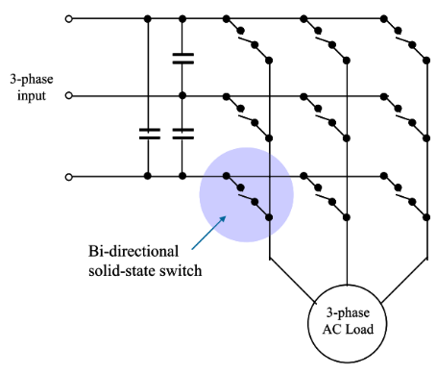
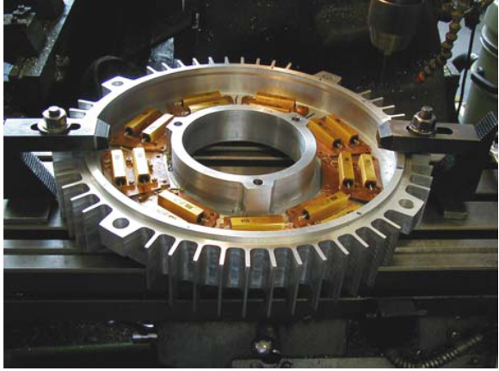
University of Nottingham
P W Wheeler, J C Clare, L Empringham, Bradley, S Pickering, D Lampard, K J, M Apap
2005, A Fully Integrated 30kW Motor Drive Using Matrix Converter Technology
Targeted at pump and fan applications, induction motor
Fully tested and evaluated demonstrations of the power converter and the cooling arrangements
30 kW prototype, power electronics housed in a re-designed End Plate, IGBT based
415 Volt, 50 Hz supply.

Slide 21
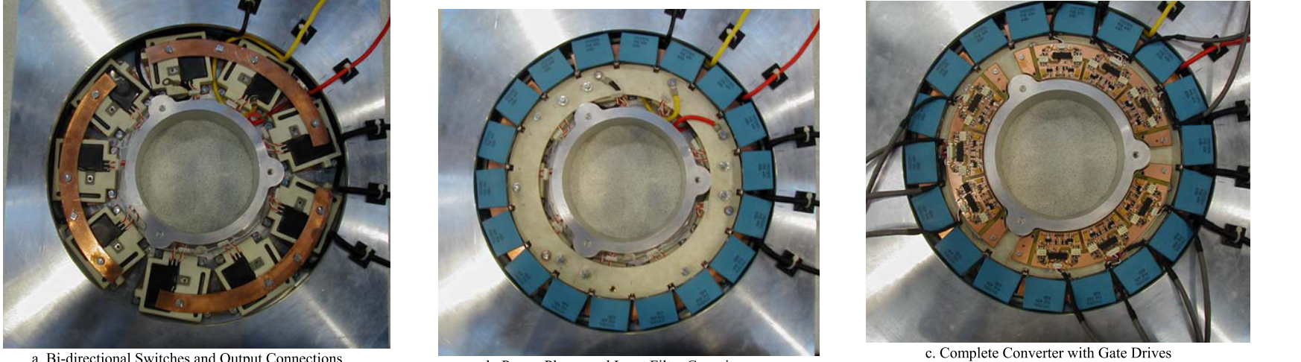
University of Nottingham
P W Wheeler, J C Clare, L Empringham, Bradley, S Pickering, D Lampard, K J, M Apap
2005, A Fully Integrated 30kW Motor Drive Using Matrix Converter Technology

Slide 22
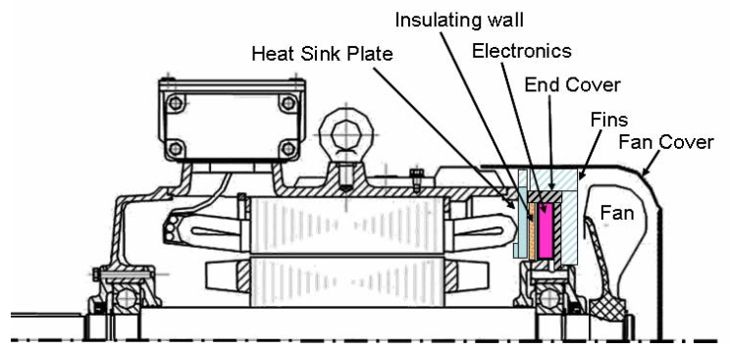
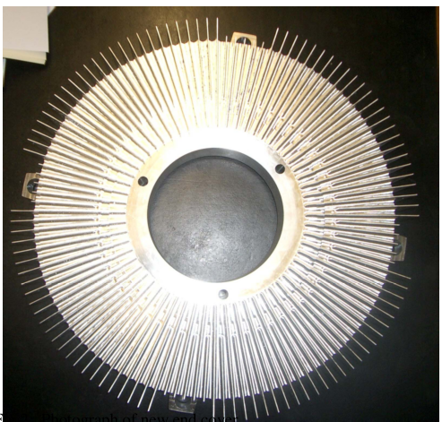
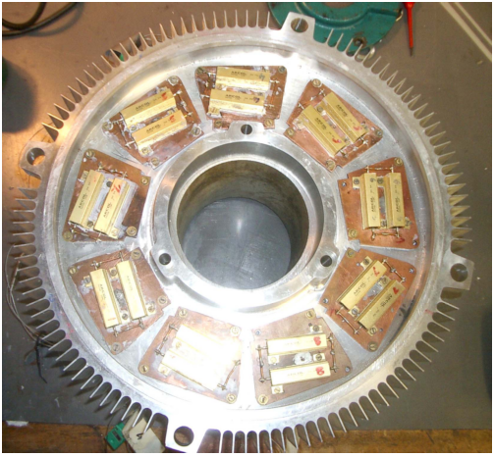
University of Nottingham
Stephen Pickering1, Frederic Thovex1, Patrick Wheeler2, Keith Bradley2
2006, Thermal Design of an Integrated Motor Drive
Computational fluid dynamics (CFD) was used to model the ventilation and heat transfer from the new end cover and to develop improved fan geometries.
30 kW, 4 pole induction motor, matrix converter.
Önceki makalenin termali

Slide 23
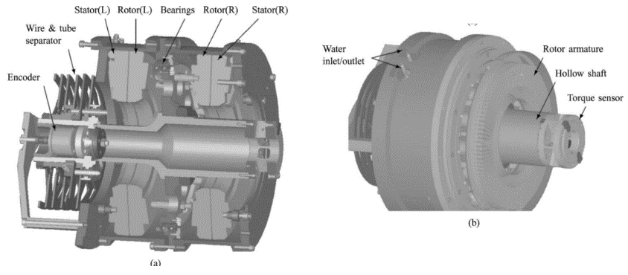
Concordia University, Montreal - Boston Dynamics
Farhad Aghili, John M. Hollerbach, and Martin Buehler
2007, A Modular and High-Precision Motion Control System with an Integrated Motor
Integrated direct-drive joint
High-precision motion control
The joint integrates a direct-drive synchronous motor with axial air gap, a torque sensor, and a high-resolution position sensor.

Slide 24
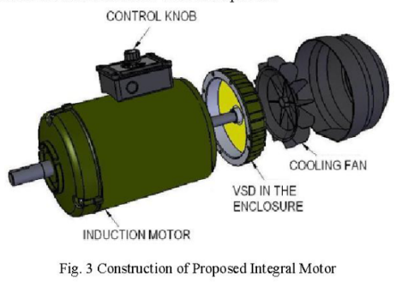
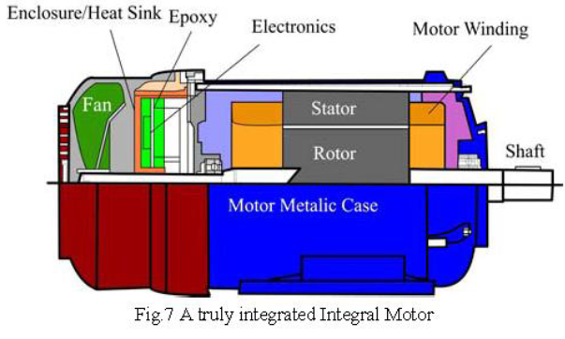
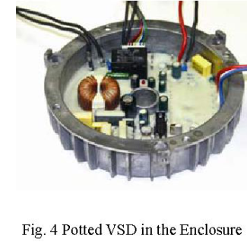
Swinburne University of Technology, Australia
Mehran Ektesabi and Hasib Felic
2007, Controlling Heat, Vibration and EMI in an Integral Motor
No modularization, induction motor, experimental verification
The proposed motor is the first truly integrated motor-drive unit with a design which overcomes heat, vibration and EMI which are damaging to sensitive electronics.
EMI results are given, passed the tests

Slide 25
2010 – 2015

Slide 26
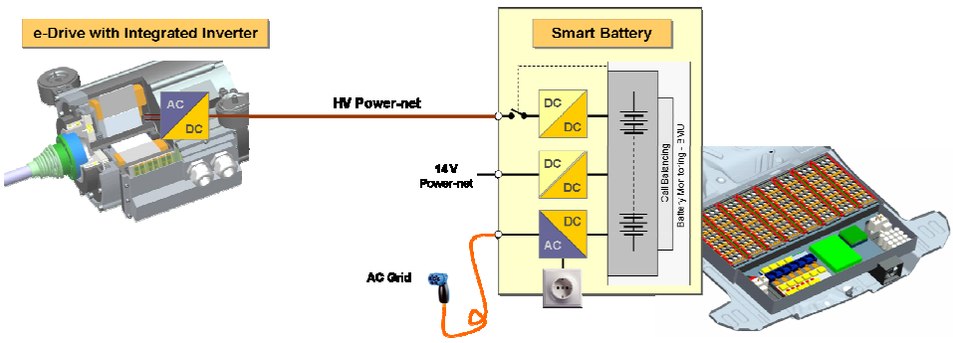
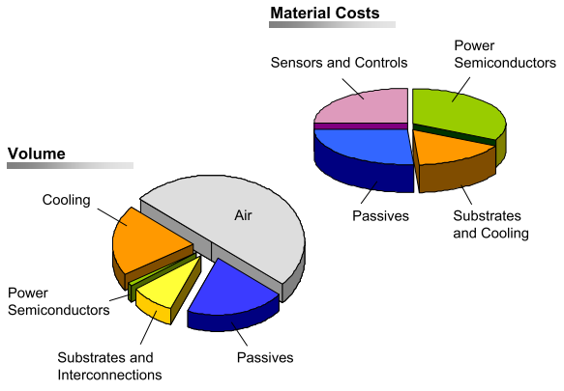
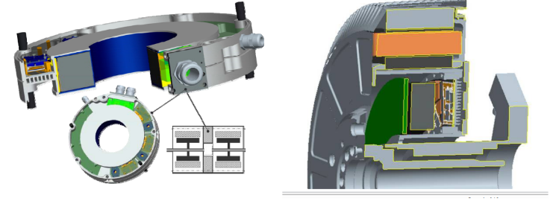
Fraunhofer Institute of Integrated Systems and Device Technology, Erlangen
Martin März, Andreas Schletz, Bernd Eckardt, Sven Egelkraut, Hubert Rauh
2010, Power Electronics System Integration for Electric and Hybrid Vehicles

Slide 27
University of Wisconsion-Madison
Gilsu Choi, Zhuxian Xu and Ming Li, Shiv Gupta and Thomas Jahns, Fred Wang, Neil A. Duffie, Laura Marlino
2011, Development of Integrated Modular Motor Drive for Traction Applications
Review of alternative concentrated winding PM machine configurations, Slot/pole combinations, SMC
Most promising controller architecture for providing a high-level of fault tolerance and robustness
A 10 kW phase-leg package using Si IGBT power devices combined with a 2-pass-tube coldplate is proposed that shows promise for holding the junction temperatures below 200°C with an ambient temperature of 150°C., IGBT switching experiments, thermal simulations
The results of these analytical and experimental studies have succeeded in setting the stage for developing a 10 kW preliminary prototype integrated motor drive during the coming year.

Slide 28
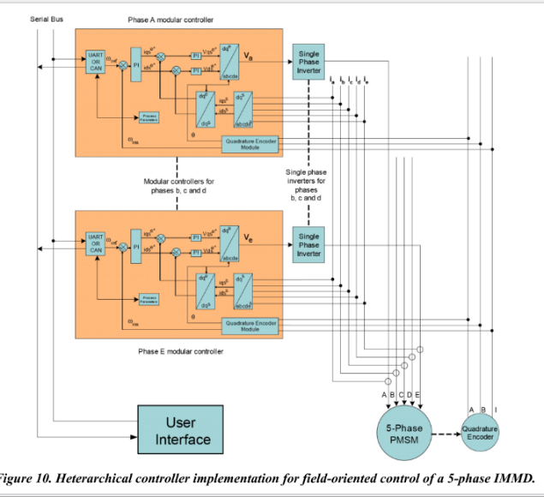
University of Wisconsion-Madison
Gilsu Choi, Zhuxian Xu and Ming Li, Shiv Gupta and Thomas Jahns, Fred Wang, Neil A. Duffie, Laura Marlino
2011, Development of Integrated Modular Motor Drive for Traction Applications

Slide 29
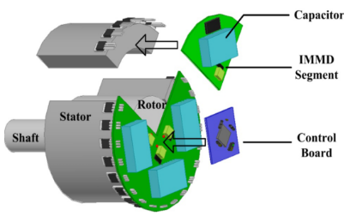
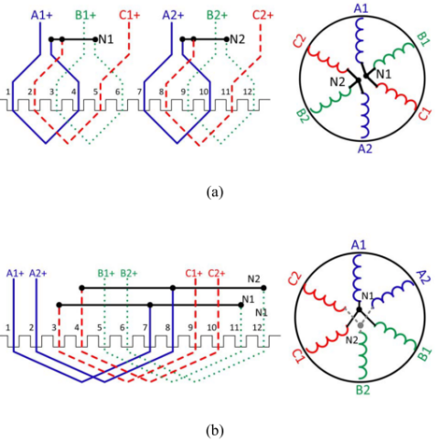
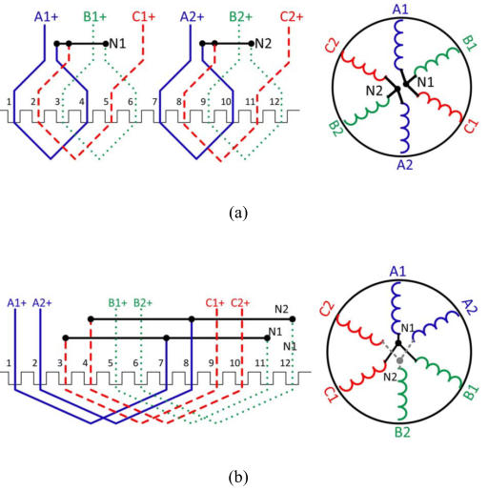
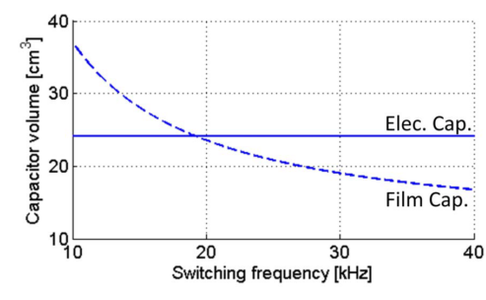

University of Wisconsion-Madison
Jiyao Wang, Ye Li, Yehui Han
2013, Evaluation and Design for an Integrated Modular Motor Drive (IMMD) with GaN devices

Slide 30



University of Wisconsion-Madison
Jiyao Wang, Ye Li, Yehui Han
2013, Evaluation and Design for an Integrated Modular Motor Drive (IMMD) with GaN devices
Series-connected inverter segments, wide bandgap 200V GaN MOSFETs
Eliminating inverter heat sink and optimizing the choice of DC-link capacitors, interleaving
Keep the height of capacitors within 1 inch, capacitor selection and comparison (AEL, Film, Ceramic)
Active DC link balancing
Experiment: 180Vdc, 7Arms, 36uF, 0.6inch height, 3 inch radius, RL load test

Slide 31


University of Wisconsion-Madison
Adam Shea (Master Thesis), T.M. Jahns
2014, Hardware Integration for an Integrated Modular Motor Drive Including Distributed Control
First IMMD prototype unit that included a dedicated controller in each module. (Second generation)
18kW (peak), 6-phase IMMD demonstrator unit for a traction drive
Heterarchical distributed control strategy, need for cooperation among the individual controllers
Maximizing the independence of each controller for purposes of reliability and fault tolerance
Master/slave control configuration
Half-bridge inverter phase-leg for each phase with two discrete 600V IGBTs in TO-247 packages. The nominal dc bus voltage is 325 Vdc.
Cooling for each phase-leg module is accomplished using an off-the-shelf copper pin-fin waterblock designed for graphics card cooling.

Slide 32
University of Wisconsion-Madison
Adam Shea (Master Thesis), T.M. Jahns
2014, Hardware Integration for an Integrated Modular Motor Drive Including Distributed Control
4 layers of copper traces. The bottom two are solid planes that form the dc-link bus. The top two layers contain the DSP controller, analog signal conditioning for voltage and current sensing, gate drivers, and communications interfaces.
The dc-link bulk capacitance is a 20µF film capacitor mounted below the controller on each module. Middle-range frequencies are decoupled using a pair of 22nF ceramic capacitors mounted very near the dc link terminals of each power module.
Bootstrap driver for the high-side IGBT switch with a matching power driver for the low-side switch. A voltage-clamped version of the half- bridge output node voltage is fed back to the controller in order to provide the necessary feedback for IGBT desaturation protection.
High-bandwidth (~10kHz) current sensing is provided by a linear Hall effect sensor mounted to the bottom of the control board.
Position sensing in this demonstrator unit is accomplished using a standard quadrature encoder. The angular position information is delivered in parallel to all six phase-drive controllers.
Module-to-module communications are handled by both analog signals for current sensing and a CAN bus. The CAN bus, encoder interface, and controls power supply are isolated from the power circuit by means of an isolated dc/dc converter and optical isolation

Slide 33
University of Wisconsion-Madison
Adam Shea (Master Thesis), T.M. Jahns
2014, Hardware Integration for an Integrated Modular Motor Drive Including Distributed Control
For grounding purposes, the controls are all connected to the negative rail of the dc bus in each module, providing a single common reference point.
IGBTs rated for a maximum junction temperature of 175°C were chosen along with capacitors rated at 125°C and a high temperature DSP controller rated at 140°C. Simulations of full-power operation predict a 5°C margin when operating with 100°C coolant for these components.
10kW surface six-phase variant of a three-phase fractional-slot concentrated winding permanent magnet (PM) synchronous machine (12/10).
The presence of two wyes makes it possible to shut one down one three-phase inverter and continue operating with half of the machine excited under fault conditions.
If excitation is removed from one of the wyes, the remaining three excited phases are distributed evenly around the stator’s periphery, minimizing unbalanced radial forces on the rotor that can stress the rotor bearings.
A stainless-steel backplate is mounted between the machine and the drive electronics to shield the electronics from fringing magnetic and electrical fields radiated by the machine.

Slide 34



University of Wisconsion-Madison
Adam Shea (Master Thesis), T.M. Jahns
2014, Hardware Integration for an Integrated Modular Motor Drive Including Distributed Control
Test:
Constant-V/Hz operation at 200Hz (2400r/min) under no-load conditions
A basic sine-triangle PWM algorithm is used for the voltage modulation with a switching frequency of 20kHz and a modulation index value of 0.95.
The drive is operating with a reduced dc link voltage of 110V
Current and voltage waveforms, hall effect sensor frequency test

Slide 35




University of Wisconsion-Madison
Adam Shea (Master Thesis), T.M. Jahns
2014, Hardware Integration for an Integrated Modular Motor Drive Including Distributed Control

Slide 36




University of Wisconsion-Madison
Jiyao Wang, Ye Li, Yehui Han
2014, A New Concept of Multilevel Converter Motor Drive with Modular Design and Split Winding Machine

Slide 37
University of Wisconsion-Madison
Jiyao Wang, Ye Li, Yehui Han
2014, A New Concept of Multilevel Converter Motor Drive with Modular Design and Split Winding Machine
Significant reduction in component quantity. does not require any extra capacitors, diodes or isolated voltage sources.
Unlimited flexibility and performance optimization, can accommodate a wide range of voltage levels and power ratings, allowing for the use of low-voltage devices.
Compatibility with different systems. Can be supplied by either a single dc source, or several dc sources to power each module.
Modular design. Manufacturing cost reduction, faster product development, easy maintenance, and simple construction. The proposed topology has identical gate signal commands for each module (with a phase-shift for interleaving)
Release of insulation burden and extended service life. The common mode voltage and differential mode output voltages on insulation layers are reduced to to Vdc/n.
Reduction in capacitor size. The capacitor size can be further reduced by the interleaving technique.
Better fault tolerance. Has access to the voltage and current of each machine winding enabling detection of machine faults through measurement of winding voltages.

Slide 38


University of Wisconsion-Madison
Jiyao Wang, Ye Li, Yehui Han
2014, A New Concept of Multilevel Converter Motor Drive with Modular Design and Split Winding Machine
The disadvantage of the proposed topology is the increased number of machine leads
Machine split winding, Gate signal interleaving, Voltage balancer. PSD söylememiş ???
Simulation: 2 modules, MATLAB/Simulink, 200Vdc, 30kHz, 1mF each, 2 A Iq
Experiment: 2 modules, 1.5kW, m/c, 200Vdc, 25kHz, 54uF each, 750rpm, 36 slot induction
A 3-lead, 3-phase, 4-pole induction motor is rewound into a 6-lead 3-phase motor

Slide 39


University of Wisconsion-Madison
Yehui Han
2014, Design, modeling, and control of multilevel converter motor drive with modular design and split winding machine
Experiment: RL load
Two inverters, 150V, 3A each, 36uF, inverter radius: 3 inch, converter height: 0.6 inch
%35 reduction in the DC link current ripple
Motor ile de test yapılmış (rewound induction)

Slide 40


University of Wisconsion-Madison
Yehui Han
2014, Design, modeling, and control of multilevel converter motor drive with modular design and split winding machine

Slide 41


University of Wisconsion-Madison
A. Shea and T. M. Jahns,
2015, Control challenges and mitigation techniques for sensor errors in modular motor drives with weakly-coupled distributed control architectures
Sensor errors and system unbalances that cause only minor performance degradation in conventional drive systems can lead to complete loss of function in modular drives with distributed control architecture

Slide 42
University of Wisconsion-Madison
Jiyao Wang, Yehui Han
2015, A Class of Modular Multilevel Motor Drives with Design Flexibility and Reduced Components Number
Inverter topologies, proposed series connected topology (1), proposed 2S 3L topologies (2-3)
Simulation and experimental results (data vermemiş)
“Common duty ratio control” is applied and there is no extra balancing control
The module with a larger DC-bus voltage will thus have a larger load current, and as a result, the DC-bus capacitor will be discharged and the DC-bus voltage will drop. This negative feedback mechanism can balance the module voltage automatically
When a module encounters a short circuit, the current will discharge the DC capacitor and its voltage will drop to zero. This mechanism prevents the module from further providing power. The total DC bus voltage will not be affected by the short circuit module, because the short circuit current will be limited within the module. Other healthy modules will share the total DC bus voltage equally. For example, when there are four modules in topology #1 and one of them becomes broken, the other three will handle 33% more voltages. It is considered safe because building the module with a 1.33 safety factor is quite reasonable. When more modules are used, the required safety factor is reduced.

Slide 43





University of Wisconsion-Madison
Jiyao Wang, Yehui Han
2015, A Class of Modular Multilevel Motor Drives with Design Flexibility and Reduced Components Number

Slide 44
University of Wisconsion-Madison
Jiyao Wang, Ye Li, and Yehui Han
2015, Integrated modular motor drive design with GaN power FETs
IMMD, 200V GaN FETs, induction motor, series connected topology, interleaving
Long cable effect, aging of stator winding insulation layers
“plug-and-play” capability
Bulky capacitors take approximately 30% of the total converter size, these capacitors are the tallest components on the printed circuit board (PCB)
Capacitor evaluation (AEC, MFC)
36-slot two-pole induction motor reconfigured to six leads, open loop V/f, SVPWM
Two inverter modules implemented with EPC GaN devices (EPC2018)
It is decided to use 50-µF capacitance in total in the hardware
The power rating of this tested motor is relatively small, the motor temperature is within limit
Experiment: Vdc = 200V, n = 2, fsw = 100kHz, Vmline = 190V, Iline = 5A

Slide 45




University of Wisconsion-Madison
Jiyao Wang, Ye Li, and Yehui Han
2015, Integrated modular motor drive design with GaN power FETs

Slide 46


University of Wisconsion-Madison
Jiyao Wang, Ye Li, and Yehui Han
2015, Integrated modular motor drive design with GaN power FETs

Slide 47




University of Wisconsion-Madison
Jiyao Wang, Ye Li, and Yehui Han
2015, Integrated modular motor drive design with GaN power FETs

Slide 48
University of Wisconsion-Madison
Jiyao Wang (PhD Thesis)
2015, Design of Multilevel Integrated Modular Motor Drive with Gallium Nitride Power Devices
A multilevel topology which utilizes semiconductor devices with lower voltage stress and better efficiency, GaN FETs
A 4-module (i.e. equivalent 5-level) prototype converter with indirect field oriented control (IFOC), experiment results
Four generations of hardware design
Topologies: 3L NPC, 3L- FC, 2n+1L CHB, Topologies with multiple DC inputs, MMC, MHF, WBG PSDs, long cable effect, examples of available commercialized integrated motor drives, Split winding machine configurations, component quantities, component sizing, voltage stress, extended topologies
Modeling and control: Voltage balancing
Capacitor evaluations: parameters, types, comparative evaluations
Interleaving: series or parallel, CM voltage/current

Slide 49


University of Wisconsion-Madison
Jiyao Wang (PhD Thesis)
2015, Design of Multilevel Integrated Modular Motor Drive with Gallium Nitride Power Devices

Slide 50
University of Wisconsion-Madison
Jiyao Wang (PhD Thesis)
2015, Design of Multilevel Integrated Modular Motor Drive with Gallium Nitride Power Devices
4-module series connected, 1.5 kW, 4-pole, 36 slot, FCM315 induction machine from Danfoss, rewound end windings
12 single-phase bridges with EPC2001C (100V, 36A) eGaN FETs from EPC, two 12 V BLDC cooling fans, a bridge gate driver LM5113 from TI and two hardware deadtime generators
Converter with 4 modules connected in series is capable of a 400 V maximum voltage and 25 A continuous current
Dual DSP control board, dsPIC33EP512GM710 from Microchip Tech. Each DSP is equipped with 6 PWM generators (12 channels), 2 I2C, 3 SPI and 2 ADC modules. The communication between two DSPs is achieved by two I2Cs, one SPI and 8 parallel ports. For debugging and monitoring, the DSP can also drive a LCD display screen via SPI.
Results:
200V DC link, 50V per module
Current waveforms (1.5A peak), module voltage balanced waveforms

Slide 51




University of Wisconsion-Madison
Jiyao Wang (PhD Thesis)
2015, Design of Multilevel Integrated Modular Motor Drive with Gallium Nitride Power Devices

Slide 52


University of Wisconsion-Madison
Jiyao Wang (PhD Thesis)
2015, Design of Multilevel Integrated Modular Motor Drive with Gallium Nitride Power Devices

Slide 53


University of Wisconsion-Madison
Jiyao Wang (PhD Thesis)
2015, Design of Multilevel Integrated Modular Motor Drive with Gallium Nitride Power Devices

Slide 54
University of Wisconsion-Madison
Jiyao Wang (PhD Thesis)
2015, Design of Multilevel Integrated Modular Motor Drive with Gallium Nitride Power Devices
The first generation: Si devices that switch at 10 kHz. The three phase converter module is realized in a single PCB design.
The second generation: Three phase module design, but uses GaN devices switch at 50 kHz. Moreover, three current sensors are added to the PCB design.
The third generation: A single phase converter piece. A large PCB area is simply occupied by copper planes and vias for heat dissipation.
The fourth generation: Parasitic inductance is minimized so the switching performance of GaN devices is good enough to realize a 100 kHz switching frequency. The overall height of this single phase piece is 1/4 inch.
Experimental results: Fourth gen (2015 makalesi ile aynı)
2 modules, 200V total, 50uF, EPC2018, 100kHz, SVPWM, V/f, Very low power, 6A peak
Module voltages (100V each), balancing results, thermal test result, motor line currents, start-up

Slide 55


University of Wisconsion-Madison
Jiyao Wang (PhD Thesis)
2015, Design of Multilevel Integrated Modular Motor Drive with Gallium Nitride Power Devices

Slide 56
AACHEN UNIVERSITY
Martin D. Hennen, Markus Niessen, Christian Heyers, Helge J. Brauer, RikW. De Doncker
2012, Development and Control of an Integrated and Distributed Inverter for a Fault Tolerant Five-Phase Switched Reluctance Traction Drive
Five phase, Outer-rotor direct drive, 67kW, 750rpm, outer rotor 320mm, Ns/Nr 20/16
Railway traction applications, 400V dc link, 30A phase current, 3.4kW, 33 uF, 10kHz
The communication, as well as the generation of the switching signals, overcurrent protection, etc., is realized on a complex programmable logic device (CPLD) on each pole module
The predictive PWM- based direct instantaneous torque control (PWM-DITC), multiphase torque sharing algorithm
Fault tolerance analysis: torque ripple, unbalanced magnetic pull, vibration shapes

Slide 57

AACHEN UNIVERSITY
Martin D. Hennen, Markus Niessen, Christian Heyers, Helge J. Brauer, RikW. De Doncker
2012, Development and Control of an Integrated and Distributed Inverter for a Fault Tolerant Five-Phase Switched Reluctance Traction Drive

Slide 58


AACHEN UNIVERSITY
Martin D. Hennen, Markus Niessen, Christian Heyers, Helge J. Brauer, RikW. De Doncker
2012, Development and Control of an Integrated and Distributed Inverter for a Fault Tolerant Five-Phase Switched Reluctance Traction Drive

Slide 59
AACHEN UNIVERSITY
Georges Engelmann, Maurice Kowal, Rik W. De Doncker
2015, A Highly Integrated Drive Inverter using DirectFETs and Ceramic DC-Link Capacitors for Open-End Winding Machines in Electric Vehicles
DC-link voltage of 145V, which is extremely close to the breakdown voltage of the DirectFETs of 150V. In the nominal operating point with a dc-link voltage of 125V, a maximum efficiency of η = 97% is reached.
International Rectifier’s (IR) DirectFET technology
Thermal resistance between junction and printed circuit board (PCB) of Rth,junction-pcb < 1 ◦C/W
Junction-to-can thermal resistance Rth,junction-can = 0.25 ◦C/W
The use of ceramic dc-link capacitors is investigated because of their higher capacity density, low ESR and good capabilities for cooling.
Six phase permanent magnet synchronous machine (PMSM) with open-end windings.
Water-cooling is implemented in the housing with a maximum coolant temperature of 70 ◦C.
It is shown that a ten times higher effective capacity density of 4.35 mF/dm3 is achieved compared to equivalent foil capacitors.

Slide 60




AACHEN UNIVERSITY
Georges Engelmann, Maurice Kowal, Rik W. De Doncker
2015, A Highly Integrated Drive Inverter using DirectFETs and Ceramic DC-Link Capacitors for Open-End Winding Machines in Electric Vehicles

Slide 61




AACHEN UNIVERSITY
Georges Engelmann, Maurice Kowal, Rik W. De Doncker
2015, A Highly Integrated Drive Inverter using DirectFETs and Ceramic DC-Link Capacitors for Open-End Winding Machines in Electric Vehicles

Slide 62


AACHEN UNIVERSITY
Georges Engelmann, Maurice Kowal, Rik W. De Doncker
2015, A Highly Integrated Drive Inverter using DirectFETs and Ceramic DC-Link Capacitors for Open-End Winding Machines in Electric Vehicles

Slide 63
Technische Universitat Ilmenau, Institute for Electric Power and Control Engineering
M.Sc. Florian Ludwig, Dr.-Ing. Tobias Heidrich, PD Dr.-Ing. habil. Andreas Möckel
2015, Integrated high-speed PMSM Drive with IMS PCB-Technology for Mobile Applications
Sensored field oriented controlled (FOC), 4-pole PMSM
Single sided insulated metal substrate (IMS) PCB mounted onto the motor end shield.
Do = 50mm, La = 105mm. Pout = 600W, Nr = 25000rpm
Active cooling strategy with a radial fan
Ceramic DC-link capacitors, two hall effect current sensors, angle encoder
Vdc = 18V, discrete DirectFETTM MOSFETs (IRF7739)
TMS320F28035, 32-bit fixed point processor, 60MHz
Test: 500W output power, 80% efficiency, thermal analyses

Slide 64




Technische Universitat Ilmenau, Institute for Electric Power and Control Engineering
M.Sc. Florian Ludwig, Dr.-Ing. Tobias Heidrich, PD Dr.-Ing. habil. Andreas Möckel
2015, Integrated high-speed PMSM Drive with IMS PCB-Technology for Mobile Applications

Slide 65

Energy and Transportation Science Division Oak Ridge National Laboratory Knoxville
Gui-Jia Su and Lixin Tang
2012, A Segmented Traction Drive System with a Small dc Bus Capacitor
Electric vehicle/hybrid electric vehicle (EV/HEV)
Currently the dc bus capacitor contributes up to 20% of the cost and weight of an inverter and up to 30% of an inverter’s volume
Interleaving, simulation (PSIM), 55 kW segmented inverter prototype, IGBT, water cooled
RL load tests, reduction of 62% for capacitor ripple current and 78% for battery ripple current
Induction motor rated at 15 HP, 230 Vrms, 37.5 Arms, 91 Nm, and 1,175 rpm.
Reduction of 73% for capacitor ripple current and 89% for battery ripple current

Slide 66
Power Electronics and Electric Machinery Group Oak Ridge National Laboratory Knoxville
Gui-Jia Su, Lixin Tang, Curt Ayers, and Randy Wiles
2013, An Inverter Packaging Scheme for an Integrated Segmented Traction Drive System
2012 yayınının integrated olanı, 55kW prototype (2 designs)
Doughnut shaped capacitors such as the Power Ring Film Capacitors with superior ripple current capabilities
Second prototype: 17.8 kW/l and specific power of 15.6 kW/kg
Resistive load bank and a commercial, off-the-shelf, induction motor rated at 15 HP (11 kW), 230 Vrms, 37.5 Arms, 91 Nm, and 1,175 rpm
The battery rms ripple current is reduced from 4.21Arms to 1.45Arms, a 66% reduction. (Resistive load)
The battery rms ripple current is reduced from 6.53Arms to 0.9Arms, an 86% reduction. (Motor load)
Because of the distributed capacitors, capacitor ripple current cannot be measured.

Slide 67


Power Electronics and Electric Machinery Group Oak Ridge National Laboratory Knoxville
Gui-Jia Su, Lixin Tang, Curt Ayers, and Randy Wiles
2013, An Inverter Packaging Scheme for an Integrated Segmented Traction Drive System

Slide 68

University of Nottingham
Robert Abebe, Gaurang Vakil, Giovanni Lo Calzo, Tom Cox, Chris Gerada, Mark Johnson
2015, FEA Based Thermal Analysis of Various Topologies for Integrated Motor Drives (IMD)
Mounting options for IMMD: Surface Mount Integration, End Plate Mount Integration and Stator Iron Mount Integration.
The FEA tool used was ANSYS steady state thermal analysis package. A 'full SiC' module was modelled with the switch ratings of 1200V; 60A and junction temperature 150°C. The full 3- φ power electronic module consists of 12 6x3mm SiC bare dies.
Surface mount: Simple mount of the converter on the machine housing or mounting modularised converter units on the housing
Effectively used the housing as the heat sink for the power module
Proper arrangements are required to be made in order to get an effective contact between the power module and the stator casing.
The converter and machine share a common thermal node – the machine housing. This allows for adoption of a singular cooling system for both machine and converter
The curved housing surface makes mounting of the converter slightly complicated.

Slide 69

University of Nottingham
Robert Abebe, Gaurang Vakil, Giovanni Lo Calzo, Tom Cox, Chris Gerada, Mark Johnson
2015, FEA Based Thermal Analysis of Various Topologies for Integrated Motor Drives (IMD)
End plate mount – external configuration
Integration of power module on the end plate is easier and the larger housing of this configuration provides better thermal distribution compared to the housing mount configuration.
The mounting platform in the surface mounted configuration is absent in this configuration further reducing the thermal resistance between the converter and coolant.
End plate mount – internal’ configuration
Power module is in direct contact with the coolant aiding a better thermal distribution in the IMD. This increases the heat transfer coefficient between the devices and the coolant resulting in a more efficient heat transfer.
The motor housing acts as a heat sink for the converter further increasing temperature distribution.

Slide 70


University of Nottingham
Robert Abebe, Gaurang Vakil, Giovanni Lo Calzo, Tom Cox, Chris Gerada, Mark Johnson
2015, FEA Based Thermal Analysis of Various Topologies for Integrated Motor Drives (IMD)
Stator iron mount
The results show that the ‘modularised endplate mount’ configuration is the most effective for temperature distribution and efficient heat dissipation in the IMD system.

Slide 71
University of Nottingham, Newcastle University
Simon M. Lambert, Barrie C. Mecrow, Robert Abebe, Gaurang Vakil, C. Mark Johnson
2015, Integrated drives for transport – A review of the enabling electronics technology
Electrical Considerations: Supply, Conversion type, Switching frequency, Output requirements, Modularity, Wide-Band-Gap devices, Filter requirements,
In traditional silicon drives in the order of tens of kW the switching frequency has been limited to <20 kHz
Advances in silicon-carbide and gallium-nitride devices capable of much higher switching rates are challenging this limitation with tens of kW drives operating upwards of 100 kHz
Increased frequency operation does however induce electromagnetic radiation and emission at higher frequency creating more EMI issues
Utilizing planar magnetics yields considerable advantages both in loss and packaging. Indeed, the height of a planar component is generally 25-50% of the height of the wire-wound counterpart
Types of capacitors and evaluation

Slide 72
University of Nottingham, Newcastle University
Simon M. Lambert, Barrie C. Mecrow, Robert Abebe, Gaurang Vakil, C. Mark Johnson
2015, Integrated drives for transport – A review of the enabling thermal management technology
Compared to a standard packaged variable speed drive the thermal management of an integrated motor drive is complicated due to the converter being in close proximity with heat sources in the machine (copper windings and stator back iron).
The thermal paths can be notionally arranged in parallel or series configuration. Another configuration may be considered whereby the two thermal energies sink to the thermal path in such a way that there is a thermal gradient in the coolant circuit between the two physical sink points, this concept could be termed parallel/series cooling.
Enabling Technologies: Improvements in machine thermal performance, High temperature devices, Passive component cooling, Coolant types, Power Electronics packaging
Motor parts temperatures (simulation)
Increased junction temperatures, effect of packaging, gate drive thermal limitations
Planar magnetics, discussed in the previous section, have higher surface area to volume ratio than conventional cores and therefore have more efficient heat conduction away from the component

Slide 73


University of Nottingham, University of Kiel Germany, University of Parma Italy
Alessandro Galassini1, Alessandro Costabeber1, Chris Gerada1, Giampaolo Buticchi2, Davide Barater3
2015, State Space Model of a Modular Speed-Drooped System for High Reliability Integrated Modular Motor Drives
Electrical drives need an improved power density, an increased reliability and a reduced specific cost.
A novel speed-drooped control system applied to motors fed by modular converters. This control technique allows to control the speed and to share the power among different segments without any direct communication between the modules
Validated with Matlab/Simulink

Slide 74

University of Nottingham, University of Kiel Germany, University of Parma Italy
Alessandro Galassini1, Alessandro Costabeber1, Chris Gerada1, Giampaolo Buticchi2, Davide Barater3
2015, State Space Model of a Modular Speed-Drooped System for High Reliability Integrated Modular Motor Drives
The main limitation of the series configuration (Fig. 1b) is the fault tolerance; in fact, if a segment is damaged all the entire system is compromised. On the other hand, in the parallel configuration (Fig. 1c) fault tolerance is guaranteed by the parallel segments.
In the past, power sharing in drive was achieved thanks to mainly three different control techniques: droop, torque follower and speed trim follower. The proposed droop method allows to control the speed, and eventually to share the power among different modules (or segments) getting the same speed input reference.
The new droop method is modular, thus in case of drive or segment fault, the system is still able to control the speed.

Slide 75


University of Nottingham
Alessandro Galassini, Alessandro Costabeber, Chris Gerada
2015, Speed Droop control of Integrated Modular Motor Drives
Focusing on reliability and fault tolerance, this paper proposes a simple speed droop controller for IMMDs.
Extending the concept of droop control to the speed loop of an IMMD, inherent power sharing among the modules and regulated speed are achieved without communication.
Simplified design procedure, validated with experimental results from a 3KW rig.
Önceki makale ile benzer giriş, same droop method
Experiment: three independent induction machines on the same shaft. The first two machines are controlled as an equivalent IMMD with n =2 fed by a custom two level inverter with fsw = 5kHz, Vdc=540V. The third motor is controlled as a load with a commercial inverter.
Motor data: 380V, 50Hz, 3kW, 1425rpm, 6.13A, 0.95 pf

Slide 76
KTH, Stockholm, Sweden
Staffan Norrga, Lebing Jin, Oskar Wallmark, Anna Mayer, Kalle Ilves
2013, A Novel Inverter Topology for Compact EV and HEV Drive Systems

Slide 77
KTH, Stockholm, Sweden
Lebing Jin, Staffan Norrga, Oskar Wallmark, Mojgan Nikouei Harnefors
2014, Control and Modulation of the Stacked Polyphase Bridges Inverter

Slide 78
KTH, Stockholm, Sweden
H. Zhang, O. Wallmark, M. Leksell, S. Norrga, M. N. Harnefors and L. Jin
2014, Machine design considerations for an MHF/SPB-converter based electric drive

Slide 79
KTH, Stockholm, Sweden
Lebing Jin, Staffan Norrga, Hui Zhang, Oskar Wallmark
2015, Evaluation of a Multiphase Drive System in EV and HEV Applications

Slide 80
KTH, Stockholm, Sweden
M. N. Harnefors, L. Jin, L. Harnefors, O. Wallmark, M. Leksell and S. Norrga
2015, Analysis of the dc-link stability for the stacked polyphase bridges converter

Slide 81
2016 - today

Slide 82


University of Nottingham
Alessandro Galassini, Alessandro Costabeber, Chris Gerada
2016, A Modular Speed-Drooped System for High Reliability Integrated Modular Motor Drives
Önceki makale ile benzer giriş
3 kW test rig
Enhanced droop-based controller for the IMMD which guarantees tightly regulated speed while arbitrarily sharing the load power among the modules
Power sharing in drive applications are achieved thanks to mainly three different control techniques: common speed reference [Fig. 2(a)], torque follower [Fig. 2(b)], and speed trim follower [Fig. 2(c)]

Slide 83


University of Nottingham
Alessandro Galassini, Alessandro Costabeber, Chris Gerada
2016, A Modular Speed-Drooped System for High Reliability Integrated Modular Motor Drives
Experiments:
The IMMD system has been emulated using three independent induction machines on the same shaft
The first two machines are con- trolled as an equivalent IMMD with n =2 fed by a custom two-level inverter, switching at fsw =5kHz and with dc bus at VDC = 540 V.
The third motor is controlled as a load with a commercial inverter (Unidrive SP by Emerson)

Slide 84


University of Nottingham, The University of Trieste
Alessandro Galassini1, Alessandro Costabeber1, Chris Gerada1, A. Tessarolo2
2017, Distributed Speed Control for Multi-Three Phase Electrical Motors with Improved Power Sharing Capability
The design procedure and the power sharing dynamic have been presented and analysed by means of Matlab/Simulink and validated in a 22kW experimental rig.

Slide 85
University of Nottingham, The University of Trieste
Alessandro Galassini1, Alessandro Costabeber1, Chris Gerada1, A. Tessarolo2
Galassini, A., Costabeber, A., Degano, M., Gerada, C., Tessarolo, A., & Castellan, S. (2016). Distributed current control for multi-three phase synchronous machines in fault conditions. Proceedings - 2016 22nd International Conference on Electrical Machines, ICEM 2016, 1036–1042.
Galassini, A., Costabeber, A., & Gerada, C. (2017). Speed Control for Multi-Three Phase Synchronous Electrical Motors in Fault Condition, (July), 6–8.
Galassini, A., Costabeber, A., & Gerada, C. (2017). Speed Control with Load Sharing Capabilities for Multi-Three Phase Synchronous Motors, 4408–4413.

Slide 86
University of Nottingham, Newcastle University
Robert Abebe1, Gaurang Vakil1, Giovanni Lo Calzo1, Thomas Cox1, Simon Lambert2, Mark Johnson1, Chris Gerada1, Barrie Mecrow2
2016, Integrated motor drives: state of the art and future trends
Integration types
Cooling systems
High temperature devices
Modular integration
Converter topologies
Passive components
Packaging of power electronics modules
Challenges in IMD design
Future trends

Slide 87

University of Nottingham, Newcastle University
Robert Abebe1, Gaurang Vakil1, Giovanni Lo Calzo1, Thomas Cox1, Simon Lambert2, Mark Johnson1, Chris Gerada1, Barrie Mecrow2
2016, Integrated motor drives: state of the art and future trends

Slide 88



KTH, Stockholm, Sweden
Lebing Jin (PhD Thesis)
2016, Integrated Compact Drives for Electric and Hybrid Electric Vehicles

Slide 89


KTH, Stockholm, Sweden
Lebing Jin (PhD Thesis)
2016, Integrated Compact Drives for Electric and Hybrid Electric Vehicles

Slide 90

KTH, Stockholm, Sweden
Lebing Jin (PhD Thesis)
2016, Integrated Compact Drives for Electric and Hybrid Electric Vehicles

Slide 91
KTH, Stockholm, Sweden
Lebing Jin (PhD Thesis)
2016, Integrated Compact Drives for Electric and Hybrid Electric Vehicles
In Publications I, II and III, modular converter topologies applicable to IMD systems are evaluated and compared in terms of efficiency, cost, control, and system performance
A thermal-electro model of power loss calculation of power MOSFETs is presented in Publication IV, which is obtained by solving the equivalent circuits for different switching periods. This model considers parasitic inductances and capacitances, and provides accurate loss estimation.
An analytical model of the SPB converter which can be used to analyze the resulting harmonics in the converter for certain modulation methods is presented in Publication V. A modulation method of harmonic elimination, by means of interleaving carriers among submodules, is proposed for the SPB converter intended for dc-link capacitor size minimization.
Considering the switching losses and the harmonic content of the dc-link current with different modulation techniques, an accurate model for estimating the required switching frequency, energy storage capability of the SPB converter and corresponding modulation method is introduced in Publication VI.
Based on the serial peripheral interface (SPI), a stable communication protocol that provides fast and accurate data transmission for the SPB converter is investigated in Publication VII.
A distributed control architecture for the SPB-type modular topologies is presented in Publication VII, which ensures stable operation under any loading conditions.
The sensitiveness of the proposed distributed control architecture to communication bandwidth and delay is investigated.

Slide 92

KTH, Stockholm, Sweden
Lebing Jin (PhD Thesis)
2016, Integrated Compact Drives for Electric and Hybrid Electric Vehicles

Slide 93
KTH, Stockholm, Sweden
L. Jin, S. Norrga and O. Wallmark
2016, Analysis of power losses in power MOSFET based stacked polyphase bridges converters

Slide 94
KTH, Stockholm, Sweden
L. Jin, S. Norrga and O. Wallmark
2016, Serial communication based distributed control of the stacked polyphase bridges converter

Slide 95
KTH, Stockholm, Sweden
M. Nikouie, O. Wallmark, L. Jin, L. Harnefors and H. P. Nee
2016, DC-Link Stability Analysis and Controller Design for the Stacked Polyphase Bridges Converter

Slide 96
KTH, Stockholm, Sweden
L. Jin, S. Norrga, O. Wallmark and N. Apostolopoulos
2017, Modulation and Power Losses of a Stacked Polyphase Bridge Converter

Slide 97
KTH, Stockholm, Sweden
L. Jin, S. Norrga, O. Wallmark and N. Apostolopoulos
2018, Communication-Based Distributed Control of the Stacked Polyphase Bridges Converter

Slide 98





KTH, Stockholm, Sweden
Hui Zhang (PhD Thesis)
2017, On Electric Machinery for Integrated Motor Drives in Automotive Applications

Slide 99
University of Wisconsin-Madison
Thomas M. Jahns and Hang Dai
2017, The Past, Present, and Future of Power Electronics Integration Technology in Motor Drives
Milestones in IMD Development History: Automotive Alternators (1960), Electronically-Commutated Motor (ECM) Blower Fan Drive (1987), Submersible Water Pump (1999), High-Speed Chiller Compressor (2000), Industrial-Grade Integrated Motor Drives (1990s to Today), Industrial Automation Servo Drives (2006), Hand Dryer Air Blower (2013)
Review of IMD Developments for Automotive Traction Drives: Merging of Powertrain Hardware with Drive Electronics, In-Wheel Traction Motor Drive (2006), Integrated Traction Motor Drives
Future Vision and Technical Challenges: Long-Term Vision for Integrated Motor Drives, Key Technical Challenges:
Reductions in power electronics cost
Overcoming maximum temperature limitations of power electronics
Development of higher efficiency power electronics
Development of improved thermal management techniques
Development of higher-temperature power electronics
Major improvements in power electronics reliability
Large repeated temperature excursions
High vibration

Slide 100


University of Wisconsin-Madison
Thomas M. Jahns and Hang Dai
2017, The Past, Present, and Future of Power Electronics Integration Technology in Motor Drives
IMD Technology Developments: Wide-Bandgap Power Semiconductors
SiC and GaN vs. Silicon Characteristics
Impact of Higher Switching Frequency on Power Converter Mass and Volume
Impact of Higher Junction Temperatures on Power Converter Mass and Volume
Integrated Modular Motor Drive (IMMD)

Slide 101



University of Wisconsin-Madison
Thomas M. Jahns and Hang Dai
2017, The Past, Present, and Future of Power Electronics Integration Technology in Motor Drives

Slide 102

University of Wisconsin-Madison, Aalto University - Helsinki
Woongkul Lee, Di Han, Silong Li, Bulent Sarlioglu, Tatiana A. Minav, Matti Pietola‡
2017, Achieving High-Performance Electrified Actuation System with Integrated Motor Drive and Wide Bandgap Power Electronics
IMD improves power density with 10-20% less volume and reduces 30-40% of the overall system costs of installation and manufacturing.

Slide 103


University of Wisconsin-Madison, Aalto University - Helsinki
Woongkul Lee, Di Han, Silong Li, Bulent Sarlioglu, Tatiana A. Minav, Matti Pietola‡
2017, Achieving High-Performance Electrified Actuation System with Integrated Motor Drive and Wide Bandgap Power Electronics

Slide 104

University of Wisconsin-Madison, Aalto University - Helsinki
Woongkul Lee, Di Han, Silong Li, Bulent Sarlioglu, Tatiana A. Minav, Matti Pietola‡
2017, Achieving High-Performance Electrified Actuation System with Integrated Motor Drive and Wide Bandgap Power Electronics

Slide 105

University of Wisconsin-Madison, Aalto University - Helsinki
Woongkul Lee, Di Han, Silong Li, Bulent Sarlioglu, Tatiana A. Minav, Matti Pietola‡
2017, Achieving High-Performance Electrified Actuation System with Integrated Motor Drive and Wide Bandgap Power Electronics

Slide 106

University of Wisconsin-Madison, Aalto University - Helsinki
Woongkul Lee, Di Han, Silong Li, Bulent Sarlioglu, Tatiana A. Minav, Matti Pietola‡
2017, Achieving High-Performance Electrified Actuation System with Integrated Motor Drive and Wide Bandgap Power Electronics
The half-bridge configuration has the smaller number of switches compared with the full-bridge configuration. However, this topology does not provide fault tolerant operation. On the other hand, the full-bridge configuration is a fully-modularized with redundant phases, which can be disconnected through a triac in the case of a fault in an associated phase.

Slide 107

University of Wisconsin-Madison, Aalto University - Helsinki
Woongkul Lee, Di Han, Silong Li, Bulent Sarlioglu, Tatiana A. Minav, Matti Pietola‡
2017, Achieving High-Performance Electrified Actuation System with Integrated Motor Drive and Wide Bandgap Power Electronics

Slide 108
http://power.eee.metu.edu.tr/
Mesut Uğur
mesut.ugur@metu.edu.tr
https://blog.metu.edu.tr/ugurm/

